Slide 1
TEAM AGILE
Team Members
Blessed Madukoma
Temitope Bamidele
Arowosegbe Iyanuoluwa
Henry Fadeni
Doreen John

Slide 2
Project Summary
Design a reproducible batch data pipeline that cleans, transforms and stores Pakistan’s Largest E-Commerce Dataset in an efficient format using a smart partitioning strategy.
The batch data pipeline aims to use the AWS S3 (Simple Storage Service) for storing the pipeline result..

Slide 3
Tech Stack
Data Loading : Polars
Data Cleaning and Transformation: Polars
Data Partioning: boto3
Data Storage: AWS S3
Data Testing: pytest

Slide 4
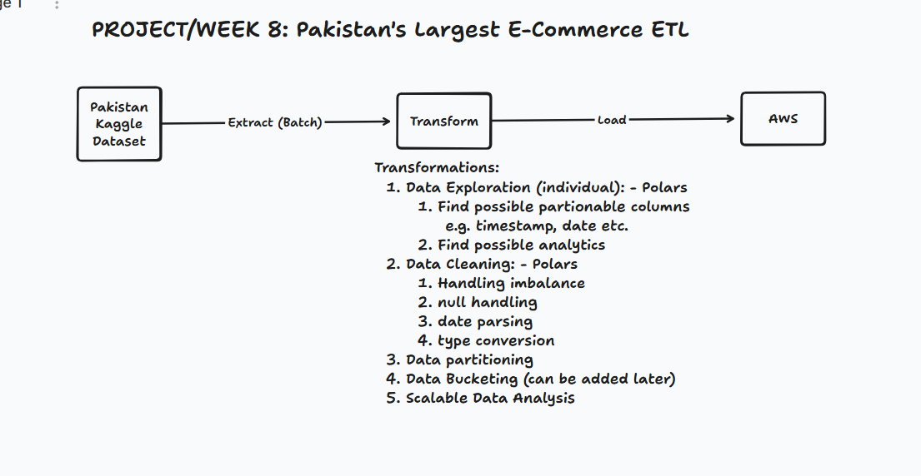
Architecture Diagram

Slide 5
Task Assignment
Data Exploration/Cleaning and Transformation
(Arowosegbe Iyanuoluwa, Blessed Madukoma)
Data Partitioning with AWS
(Henry Fadeni, Temitope Bamidele)
Testing
(Henry Fadeni, Arowosegbe Victor)
AWS S3 monitoring
(Temitope Bamidele)

Slide 6
Progress Update
High Cardinal Columns for Partitioning Identified.
Month
Year
BI Status
FY
Price Implication for AWS storage investigated.
1 gb storage unit per month
100 PUT request
100 GET request
0.02USD per month

